Slide 1
Building A Self-Sustaining Developer Community Within Your Own Walls
Matt Ring – Agile / Technical Coach
John Van Roekel – Enterprise .NET service Product Owner

Slide 2
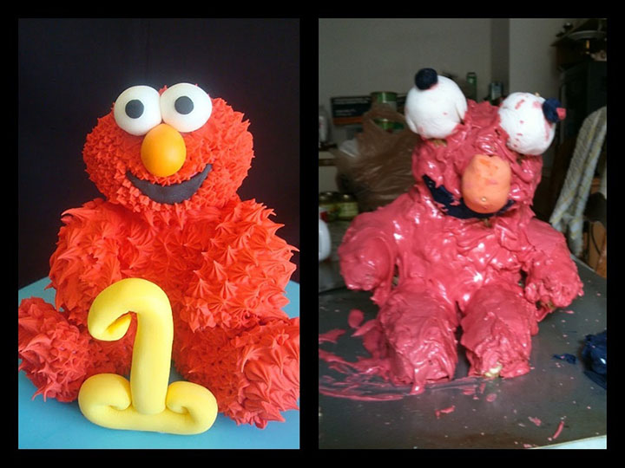
Caveat: This is not a prescriptive approach
Notes:
The following practices are what we experimented with and experiences based on our company’s culture. You’re results may vary. ☺

Slide 3
Why do we care?
Notes:
Transform local discoveries into global improvements (DevOps Handbook, pg. 42)

Slide 4
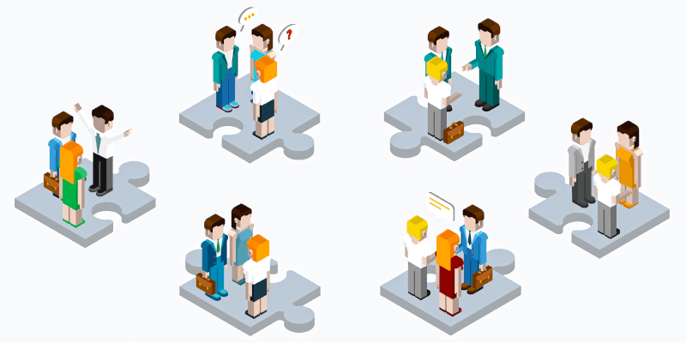
Knowledge silos
Notes:
How do you get these groups to share information between them? Brake down barriers and connect people.
Powershell Group – Figure out how do we share scripts and modules with others?
“I know some people who know some people”
Tribal knowledge goes deep, and can’t be leveraged by others unless it’s shared
Hub and spoke model, vs interconnected model (Matt and John know others so everyone comes through us, vs everyone shares with everyone else and knowledge gets spread further)

Slide 5
The third way – the best way?

Slide 6
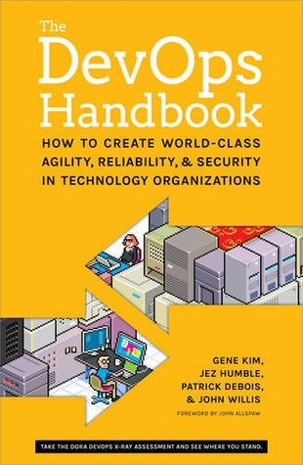
It’s Part of DevOps – The three ways

Slide 7

The First Way: Flow
Notes:
First Way: Flow (Improve the process, automate, make it better)

Slide 8

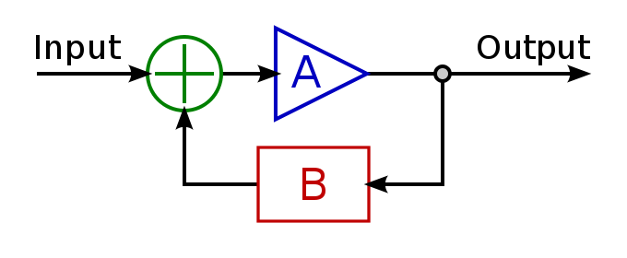
The Second way: feedback
Notes:
Second Way: Feedback
Using Data to drive the process and priority
Shorten Feedback loops to understand where your system is working, and where you want to invest further

Slide 9

The third way: Learning and experimentation
Notes:
Continual Learning and Experimentation

Slide 10

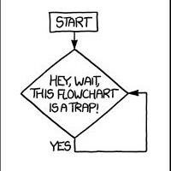

It’s Part of DevOps
Notes:
DevOps is the union of people, process, and tools, and our focus is on the people/culture aspect
People/Culture
Process
Tools

Slide 11
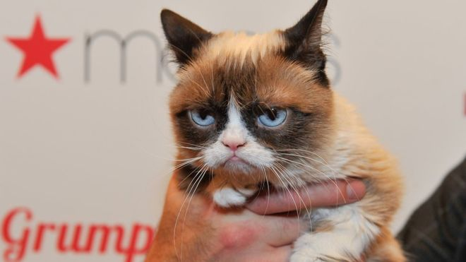
“Touchy-feely” part of DevOps

Slide 12
Practices to break down knowledge silos
Notes:
So where do we start?
What are some things we’ve tried to do to break down the knowledge silos?

Slide 13


Communication: Email vs. Blogs
Email | Blog
Responses Not Viewable by all (DO NOT REPLY-ALL) | Everyone can join the conversation
Snapshot in time | Can Be a Living Record/Updatable
Not Discoverable | Searchable, Link-able
Notes:
Here’s why email sucks…for knowledge sharing…
Two-way feedback loop
E-mails are one-way communication; responses not viewable by all (unless you reply all. “Please do not reply-all”)
E-mails are snapshot in time. Bad discoverable record to refer back to.

Slide 14
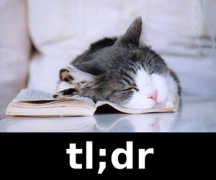

Blog Communication
Notes:
TL;DR. People don’t care about what you have to say. They care about solving their own problems. Cater it to them.
Concise and to the point
Have a hook to get your reader engaged up front
The reader doesn’t care at all what you have to say
(think about when you read blog posts, do you care about the person who wrote it, or do you just want to get some info you can use?)

Slide 15

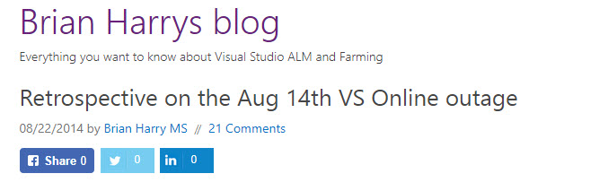
Blog Authenticity
Notes:
Readers relate better when you share the successes and failures. When you act like a know-it-all, the trust will break down, and people won’t connect or care about what you have to say.
When a new tool comes out, don’t claim to be an expert, ask for others to share their knowledge as well.
Generative culture: “Failure causes inquiry”
Blameless post-mortems
Example: Brian Harry VSTS outage posts

Slide 16
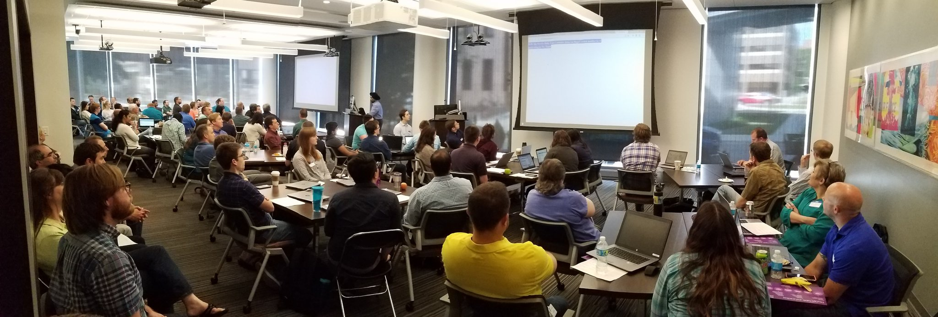
Internal Developer Conferences
Notes:
E.g. .NET Developer Day Conference, IT Forums
Internal events can be less intimidating for speakers than external conferences of strangers
Get lots of people together to network and learn
Experiment with different things you’ve seen at other conferences (Code Labs)
High Effort/High Value

Slide 17
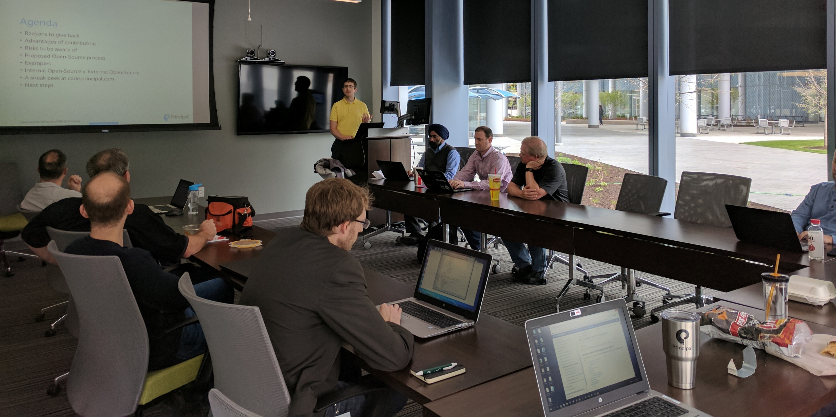
Lunch & Learns
Notes:
Provide food if you can, get’s people to come: Come for the food, stay for the learning

Slide 18

Lightning Talks
Notes:
5-10 minutes
Informal show-and-tell, demo, article I read + my thoughts, etc.
Less intimidating than speaking for 45-60 minutes

Slide 19
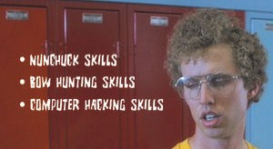
Finding hidden skills
Notes:
Give them a forum to share what they’re passionate about
Lots more skills in your company than you might think (Maybe someone in your company has figured out what blockchain is good for!)

Slide 20
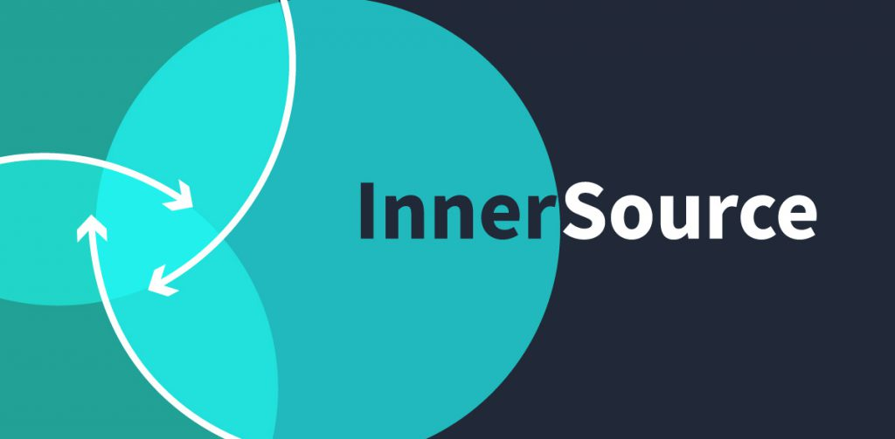
Internal Open Source (Innersource)
Notes:
An opportunity for people to contribute without having to give a talk
Share code with the community, that you wouldn’t necessarily want to go outside of the company
Tailor the code to your company infrastructure/restrictions/requirements/etc.
Get others at the company to help create the tools that will help everyone

Slide 21
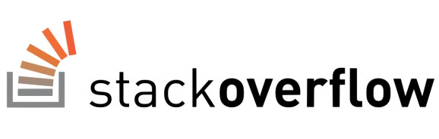

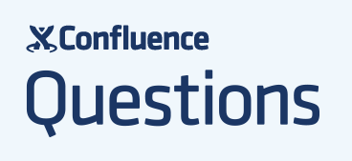
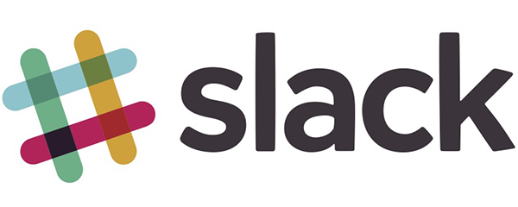
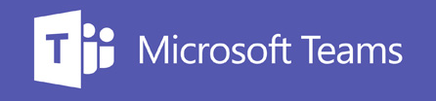
Internal Q & A / Forums
Notes:
Ask question, get internal community responses.
Tailored to company infrastructure (better than public community posting)
Confluence Questions, StackOverflow, etc.
Chat rooms (Slack, HipChat, MS Teams, etc.)

Slide 22


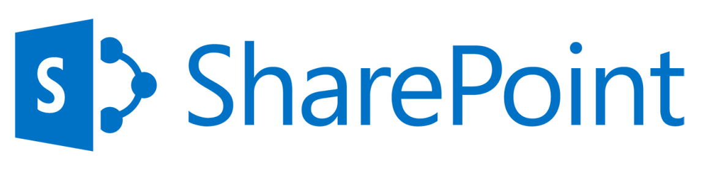
Internal Community Wikis
Notes:
Knowledge base of leading practices, how-to’s, etc.
Confluence, Wiki, SharePoint (*shudder*), etc.
GitHub markdown wiki (what is docs.Microsoft.com) running on?
Make it open for anyone to contribute content, not just SME’s
Approval gates have pros & cons

Slide 23
Common themes
Regular Communication
Share Knowledge
Get Others Involved

Slide 24
Where do we start?
Notes:
So where do we start?

Slide 25
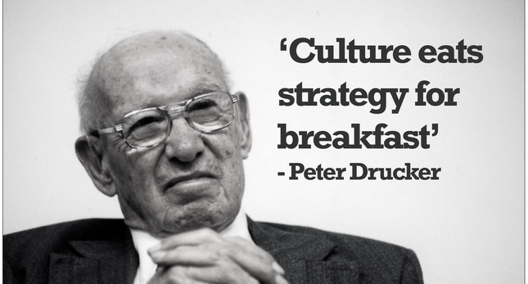
Notes:
No matter how sound your strategy, how clear your plan for making a change, the culture will dictate its success. If your culture is not one of sharing, experimentation or growth today, no strategy will on its own change that.
Peter Drucker was an Austrian-born American management consultant, educator, and author, whose writings contributed to the philosophical and practical foundations of the modern business corporation. He was also a leader in the development of management education, he invented the concept known as management by objectivesand self-control,^{[1]} and he has been described as "the founder of modern management".

Slide 26
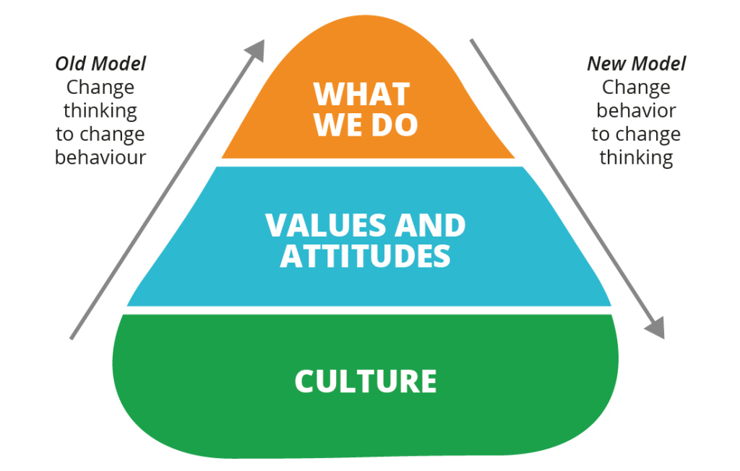
John Shook’s Change Model
Notes:
Shook’s model highlights that transformation starts from our behavior. Therefore, to start changing culture we need to change how people do their work.
To create a developer community that embraces learning, knowledge sharing and experimentation, start by doing.
~~~~~~~~~~~~~~~
https://barryoreilly.com/2017/01/18/leading-culture-change-means-changing-yourself-before-others/
“John Shook was the first American manager to be hired by Toyota. He moved to Japan without knowing a word of Japanese, just a desire to immerse himself in the organization for a prolonged period of time to learn the Toyota Production System by doing it.
What he observed was not a group of managers telling people what to think, or how to perform their work. Instead he experienced the deliberate practice of experimentation, reflection and improvement by all employees in the entire organization. Toyota had developed a set of behaviors that advocated continuous learning and adaptation to new circumstances.
What Toyota understood is that culture and circumstance is always unique and changing, and to manage change one has to be ready to learn, adapt, and apply new changes as they are happening.”

Slide 27
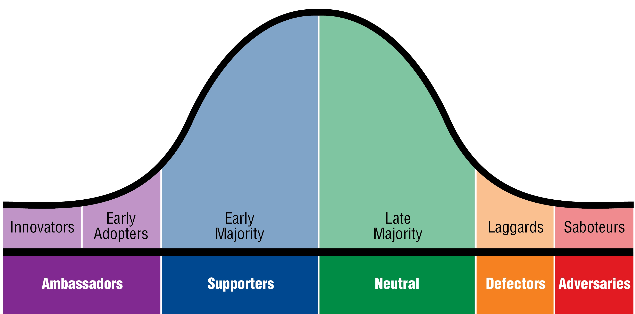
Roger’s Innovation Adoption Curve
Notes:
Focus your energy on the Innovators and Early Adopters here. Seek out those in your community to fall in this range and further those relationships. Get them to contribute to your learning culture.
These quick wins will win over those in the early majority, then eventually those in the late majority. You may never get the laggards / saboteurs on board so don’t waste your time on them.
Diversity is also important here. Not just traditional diversity (gender, race, etc.) but also cognitive and experiential diversity. Seek out alternate ideas that still align with the desire to advance a growth- and learning-culture.

Slide 28

Measure your Progress
Vanity Metrics (easier to game)
Blog page hit counts
Blog/newsletter subscribers
# registered attendees
Actionable Metrics (more valuable)
Engagement (# blog comments / commenters, unique visitors, actual attendees)
# OSS contributions

Slide 29
It won’t happen overnight…
2012
Sept. – First guest blog post
Spring - Invited external local user group
2014
2015
Enabled community contributions to Confluence space (“open-wiki” style)
First guest blogging series (5-6 guest post)
2017
2018
May – First community blog post
2013
Changed blogging platform to improve two-way feedback (one word: SharePoint).
First internal developer-focused event (.NET Developer Day)
Organized “watch party” for external streaming event (Microsoft Connect();). Low attendance.
Started monthly Lunch & Learns
Published 1st Internal open-source project
2016
Notes:
Timeline of our journey toward growing our internal .NET developer community at Principal.

Slide 30
Even after six years, it still takes continuous care & feeding.
but there are more folks to share the effort now…
You are here

Slide 31
Closing Challenge
How will you share what you’ve learned at this conference back with your community (not just your boss)

Slide 32
Thanks for sticking around
Any Questions?

